Slide 1

Real-time Monitoring System
Presented by Group 5
Zhicheng Pan(104639463) Rui Wang(104491717)
Yunpeng Bai(104462928) Chao Zhang(104656305)
Xiaoliang Duan（104506882）
60-656 Advanced Systems Programming

Slide 2
System outline
Inception highlight
Goals and risks
Use case overview
System design overview

Slide 3

Inception Highlights
Vision: Real-time monitoring system
Configuring the server side by using a shell utility tool
Monitoring the workload and performance of cluster servers by using an android app client
Getting Alarm Messages via twitter
Notes:
Pet management provides many benefits to the users and administrators. It will have all the records of pet even pet-information updates, and information will be given in details to the pet owner. Additionally, that will remind the users what they should do to keep a pet. moreover it will also show the schedule, according to their pet respectively. It will be assumed like their family doctor who is concerned about the pet

Slide 4
Goals and Risks
Goals Accomplished:
Phase I: We planed and developed the initial functionality
Phase II: we deployed these basic features(configuration, monitoring and getting alarm information )
Selected Key Risks:
Limited time to know each others’ strong and weak points
Limited experience of android designing
Amount of testing need to do

Slide 5
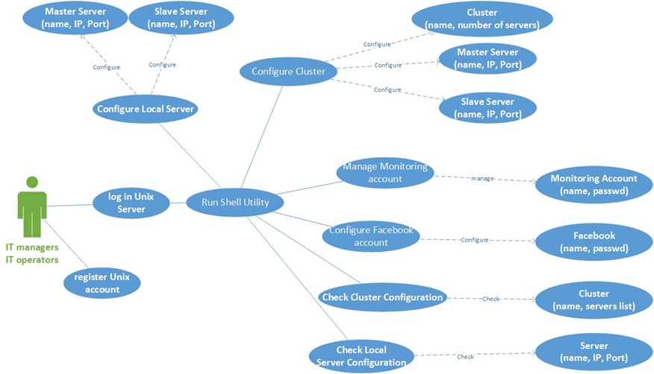
Use case overview
The system has three parts configuration, monitoring and getting information alarm
1. Configuration
twitter

Slide 6
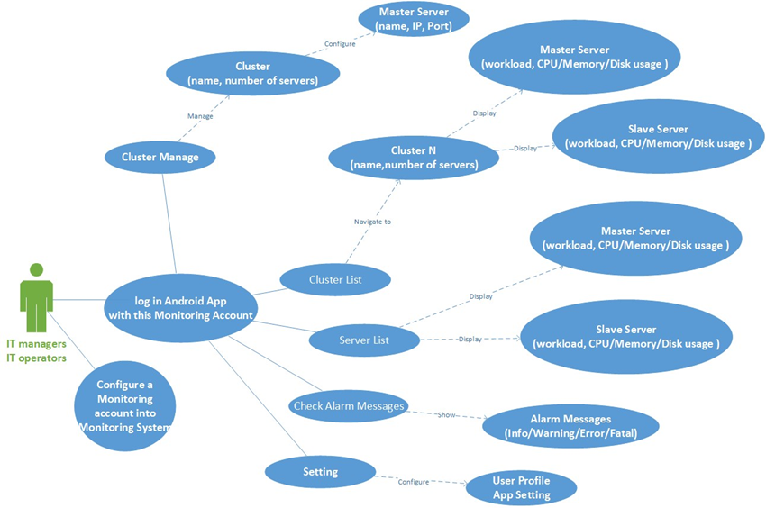
Use case overview
2. Monitoring

Slide 7
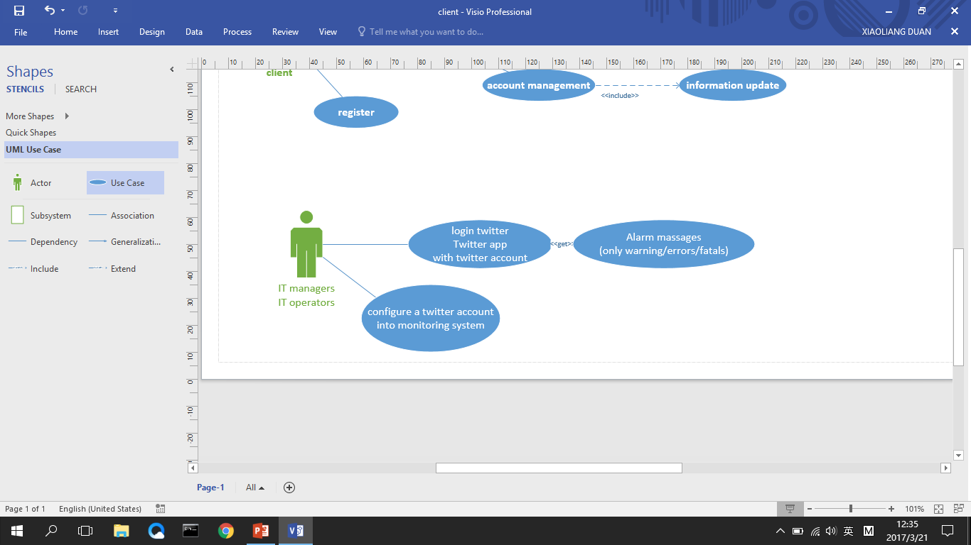
Use case overview
3. Getting information alarm via twitter

Slide 8
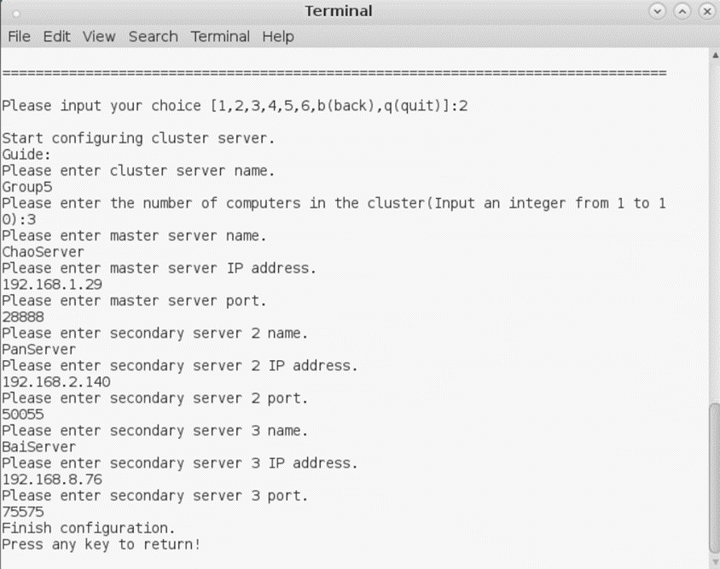
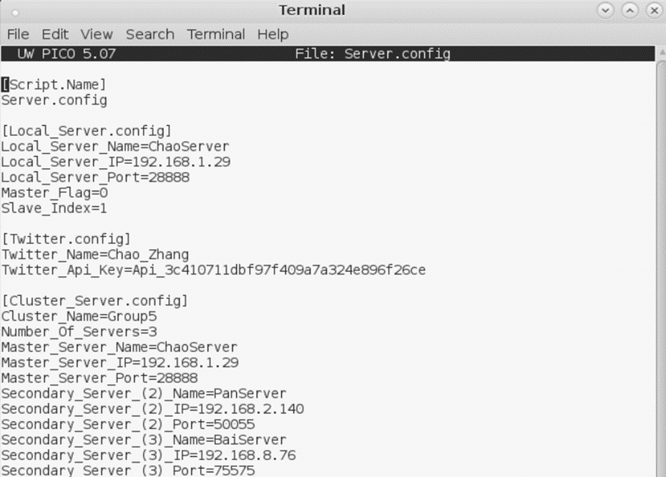
System Design Overview ---shell configuration
1.Shell —Configure Servers

Slide 9
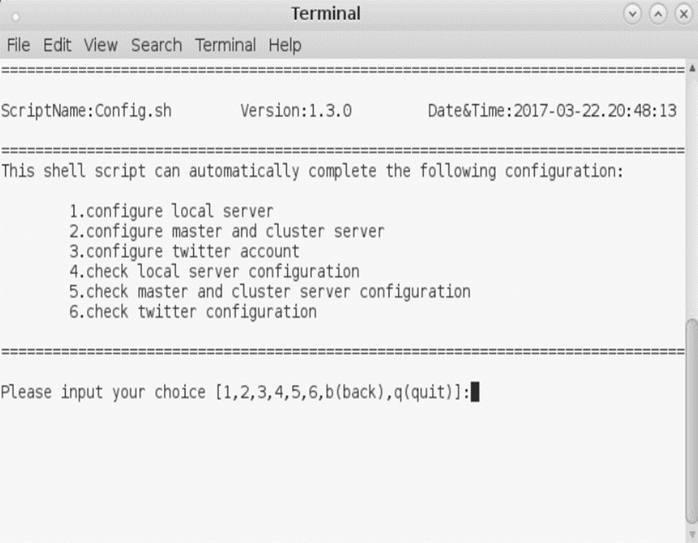
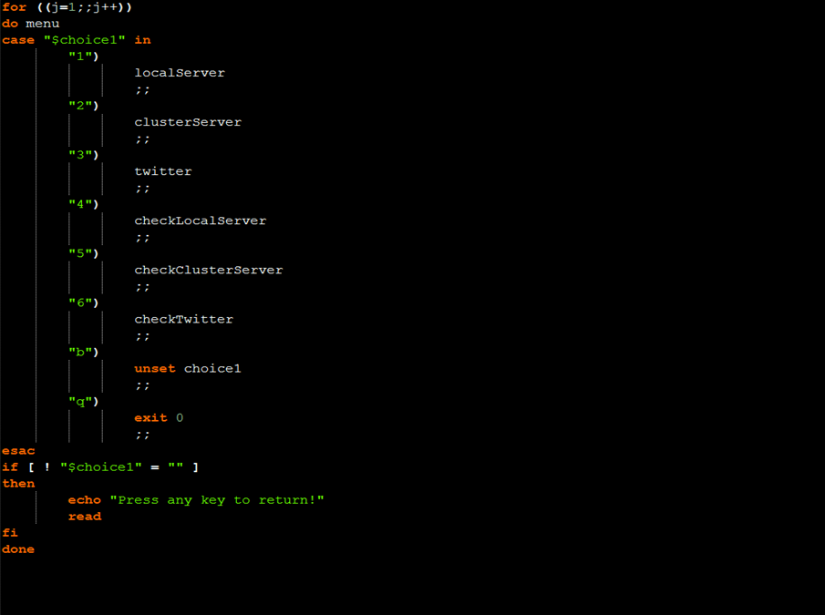
System Design Overview ---shell configuration
2. Shell — Manager Interface

Slide 10
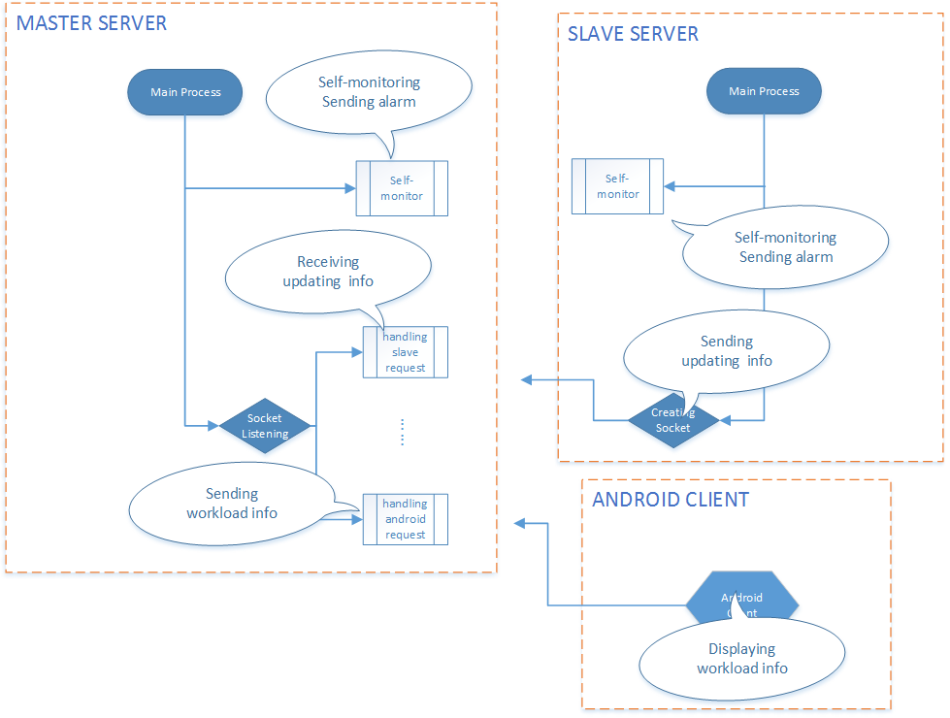
System Design Overview ---server
Architecture & Features

Slide 11
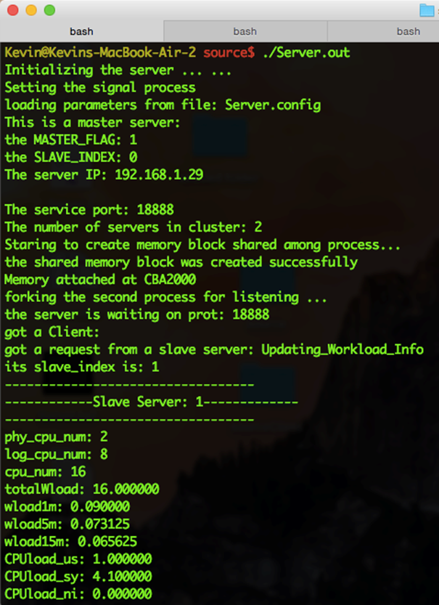
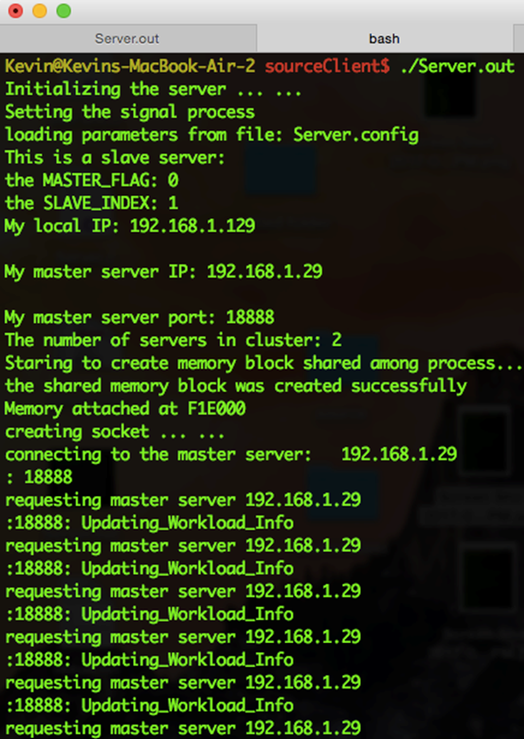
System Design Overview ---server
Screen shot: master sever vs slave server

Slide 12
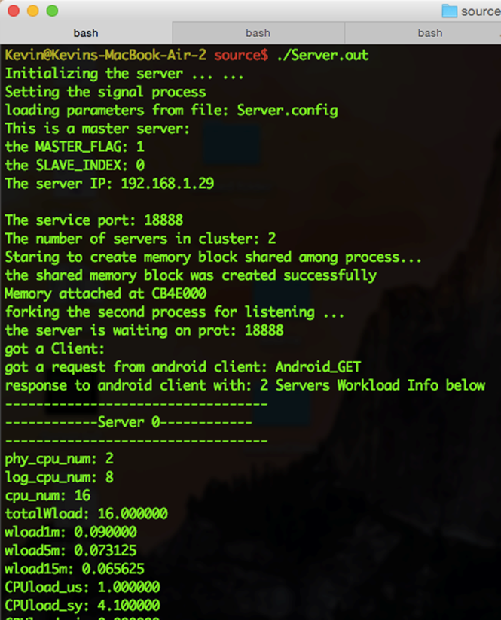
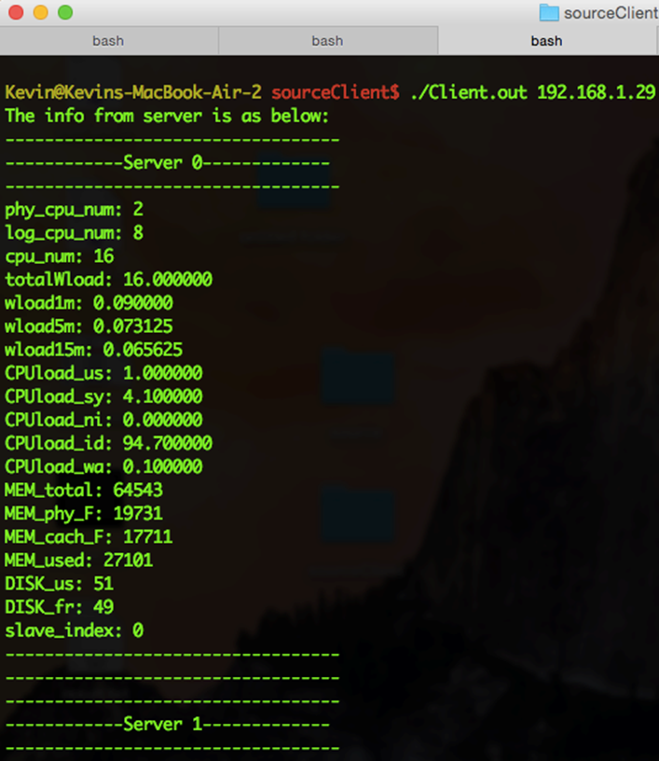
System Design Overview ---server
Screen shot: sever vs android client

Slide 13

System Design Overview --Android Client
What android client can do?
Let user check cluster running
status more easily by using visual
interface.
The data will show as a chart to
make it more intuitive
The app is fit for portable devices.
User no need to type any command
and can access anywhere they want.

Slide 14
System Design Overview --Android Client
add cluster (form: “IP:port”)
show the cluster list
chose one of the cluster
show the server list
link to one of the server
server send a package through socket to android client

Slide 15
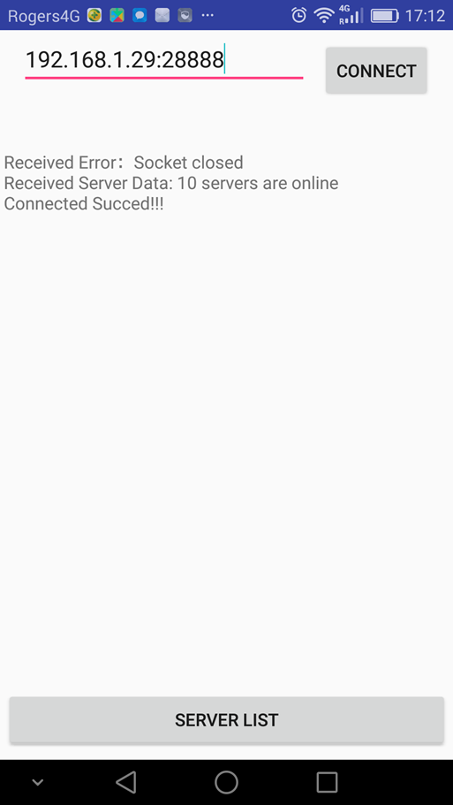
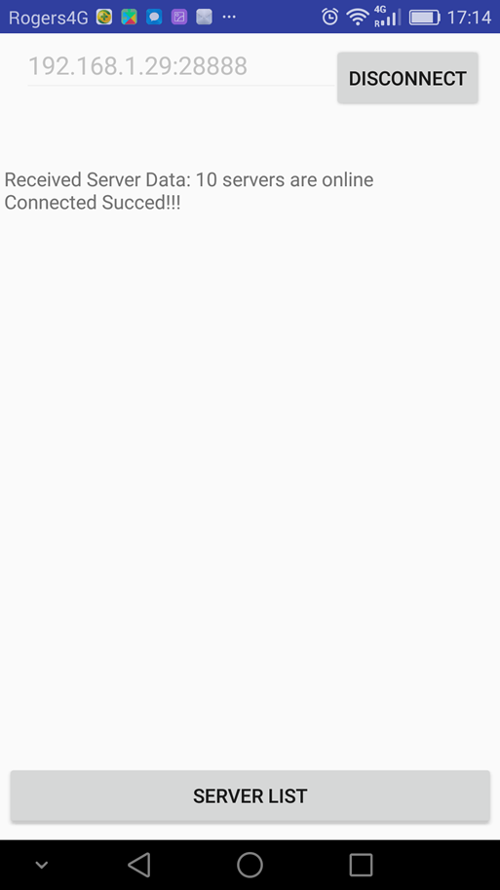
System Design Overview --Android Client
Add cluster.
By typing in the cluster
IP address and offering a port,
the android client can connect
to the cluster

Slide 16
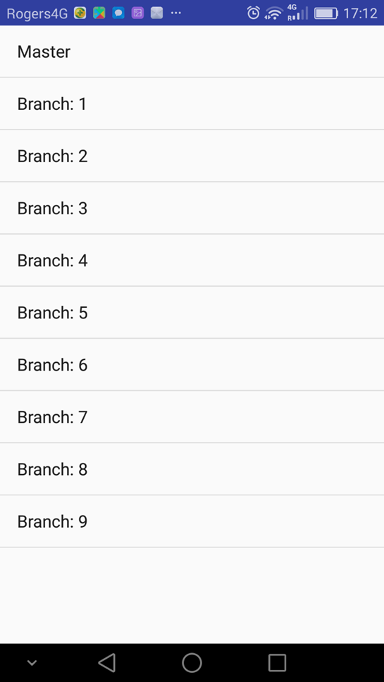
System Design Overview --Android Client
Show server list
After successfully connect to the cluster,
the android client will show the server
list and the client can choose one of the
server to check the status.

Slide 17
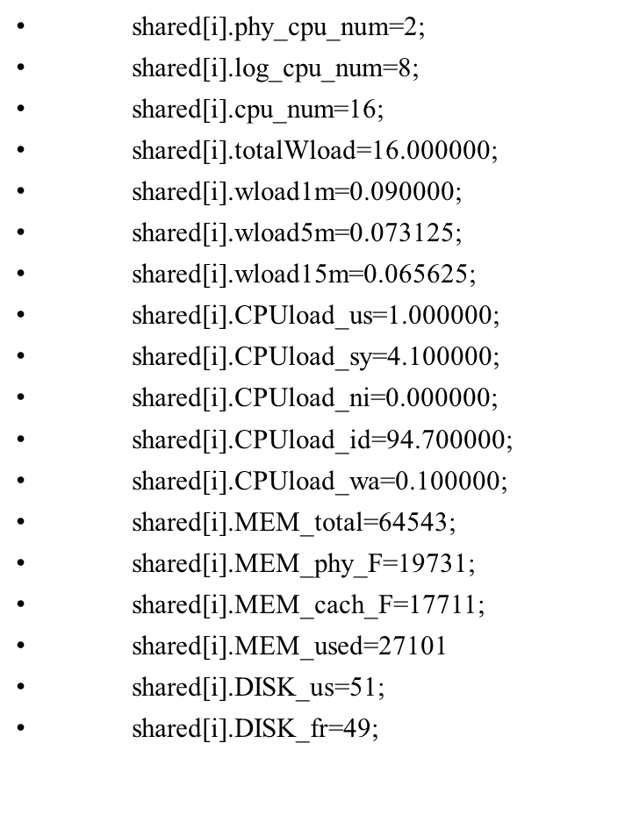
System Design Overview --Android Client
Server send a package to android client
through socket
The part of package is show on the right
As we can see, the pack is a series of
variable which store the server system
running data.

Slide 18
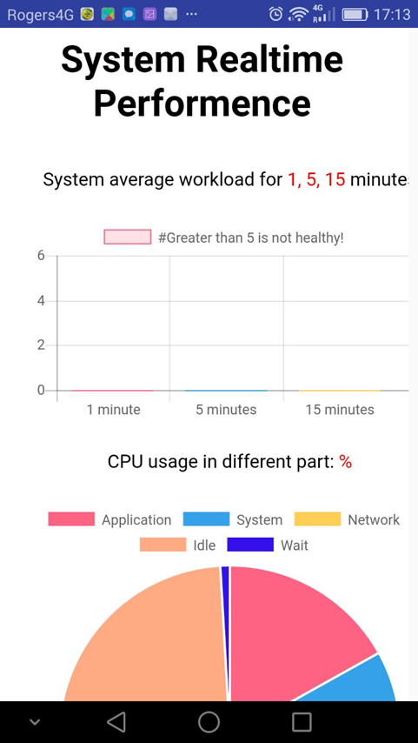
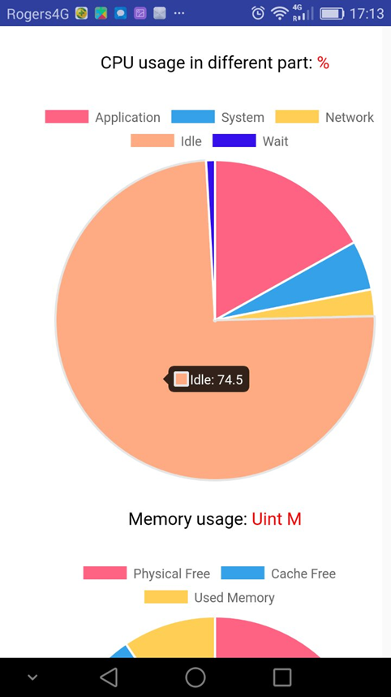
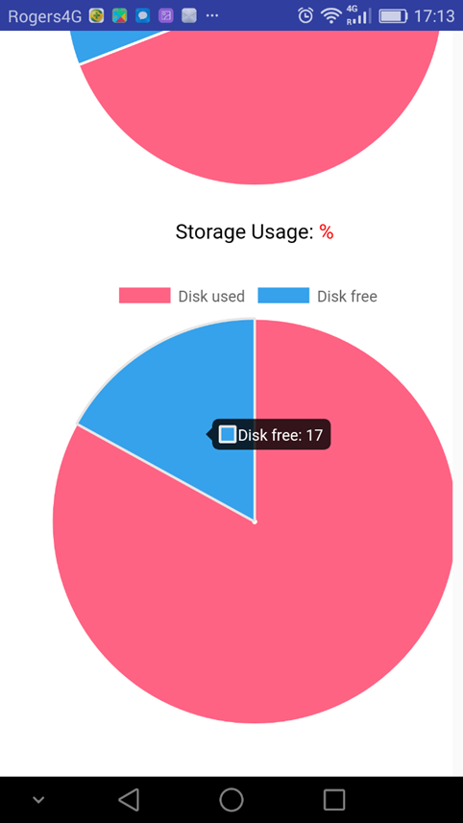
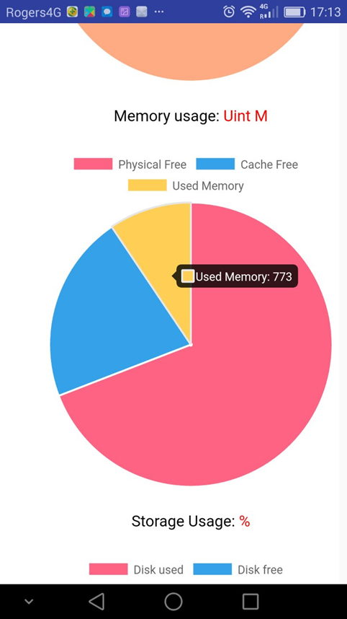
System Design Overview --Android Client

Slide 19
Summary
Development languages: C, Java, JavaScript
Development tools: Visual Studio, Eclipse and Android Studio
Software Version Control/Repository:
https://github.com/Eason2001/Unix_Servers_Real-time_Monitoring_System
Module testing tool:
Android Client Testing tool, TCP analysis and testing tool

